Slide 1
GUI REGISTRATION FORM
Using Tkinter and mysql database

Slide 2
PRESENTED BY
ABHISHEK BORA
B.HIMANTH
DEVIKA R
GANASHREE M C
RAHUL

Slide 3
INTRODUCTION
In today's digital age, registration forms are an essential component of any application or website that requires user registration. With the increasing demand for user-friendly and efficient registration processes, it has become necessary to develop tools that simplify the process. One such tool is the Python tkinter library, which enables developers to create desktop applications with a graphical user interface.
In this project, we aim to create a user registration form using the Python tkinter library and MySQL database. The registration form will be designed to collect basic information such as name, email address, and password from the user. The data entered by the user will be stored in a MySQL database, which will enable us to perform various data processing and analysis tasks.

Slide 4
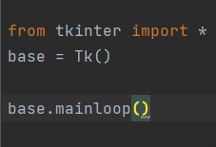
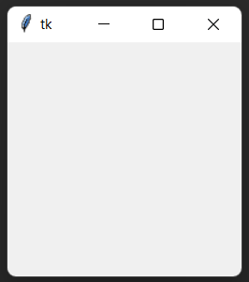
CREATING THE GUI REGISTRATION FORM USING TKINTER IN PYTHON
Firstly, we import the Tkinter module into the python program.
The line of code ‘base = Tk()’ creates a new instance of the Tkinter ‘Tk’ class, which allows us to create the main window of the GUI and we are just giving the window name as ‘base’.
Now to access the window we use the code ‘base.mainloop()’ which tells the program to enter a loop that waits for the user to do something, like click a button or type some text, and then handles that input by updating the GUI accordingly. Now if we run the program we will get a blank window on the screen, something like this-

Slide 5

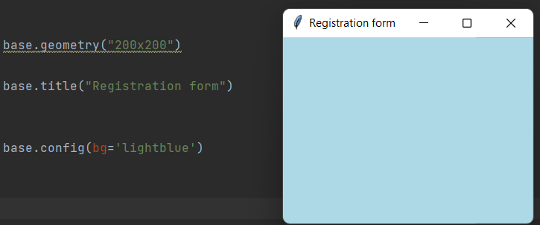
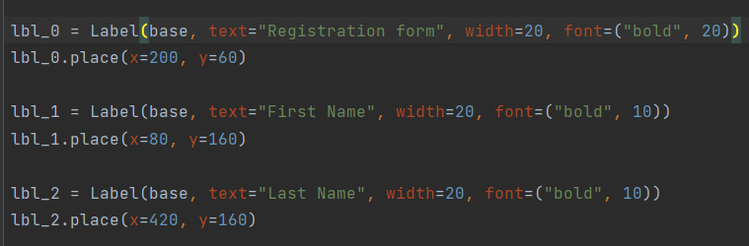
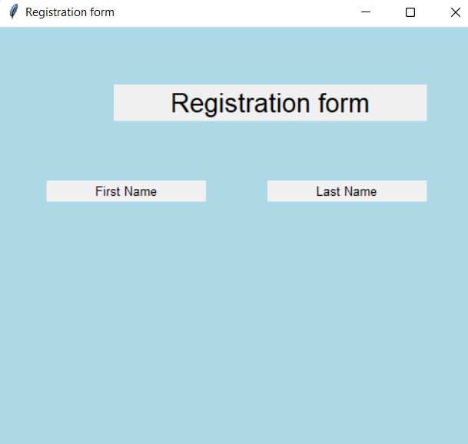
Next we assign dimensions(length and width ) to the window using ‘base.geometry(“lxb”)’. Then
We add a title to our Window using ‘base.title(“title name ”)’ and provide a background color using
Base.config(bg=“color”). The config() method is a built-in method in tkinter that is used to modify the attributes of a widget.
Now we use ‘label’ method to add widgets in the registration form and use place() method to set their positions using x and y co-ordinates and also giving styles to the labels.

Slide 6
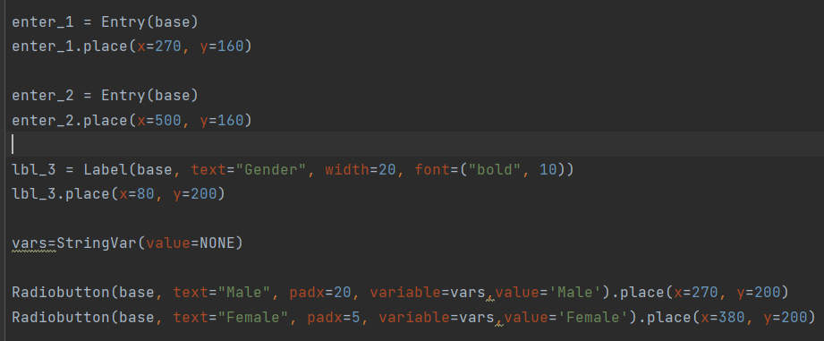
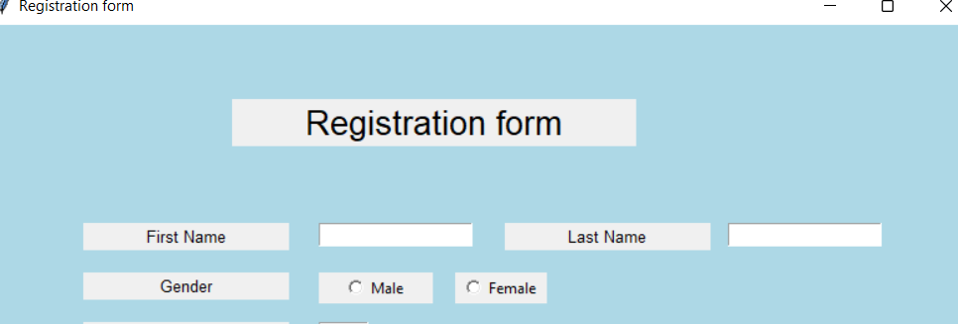

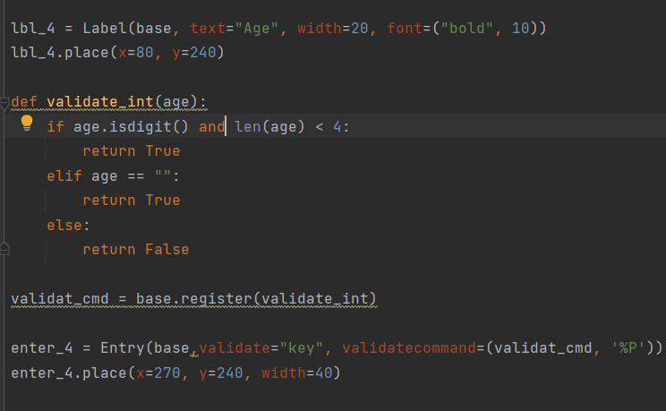

After placing labels we use the Entry widget to make a text entry box and place them for accepting the input string in text from user.
Similarly Placing the gender label and radio buttons (male and female) and using a variable ‘vars’ to store the values of the radio button.
Next we add the age and email label and the entry widgets next to them. In the Age Entry box we restrict the user to using only integers upto 3 digits so we create a method for validation.

Slide 7
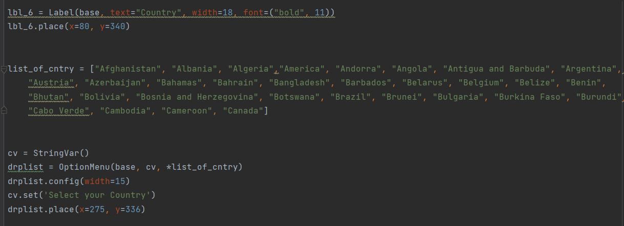


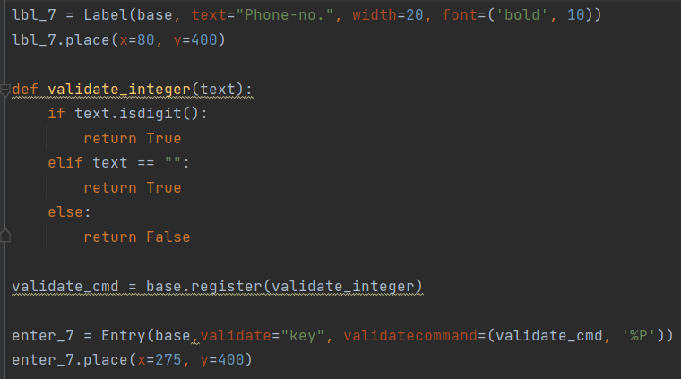


Now we ask the user to select their country and for this we create a label (country) and add a dropdown list next to it which contains a list of all the countries.
Next we add a Label for phone-no. and and add a entry box next to it. We validate the entry box to collect only digits from the user. We also create a submit button at last.

Slide 8
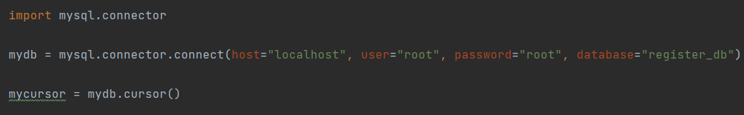
Creating a Database
We now create a database register_db and a table formdata containing the column names in MySQL.
Database connection
After the above step we then import the python library mysql.connector and then create a connection through the object ‘mydb’. Next we use the cursor() method to check whether the given configurations/parameters used to establish a connection are correct and it also allows us to interact with a database and handle all sql activities (execute Sql statements and fetch result from a DB).

Slide 9
Retrieving user input data
Continuing from the previous slide, now we create variables that correspond to the column names in mysql database and accordingly add the entry box/text fields. The .get() method is used to retrieve data from the input fields.
Next we use the execute() method to execute sql statements against a database. The SQL statement being executed here is an INSERT statement, which inserts a new row into a table named ‘formdata’. The values to be inserted are specified using placeholders ‘%s’ in the SQL statement. These placeholders are then replaced with actual values using a tuple (First_Name,Last_Name,Gender,Age,Email,Country,Phone_no).
Once the query is executed, the changes are committed to the database using mydb.commit()

Slide 10
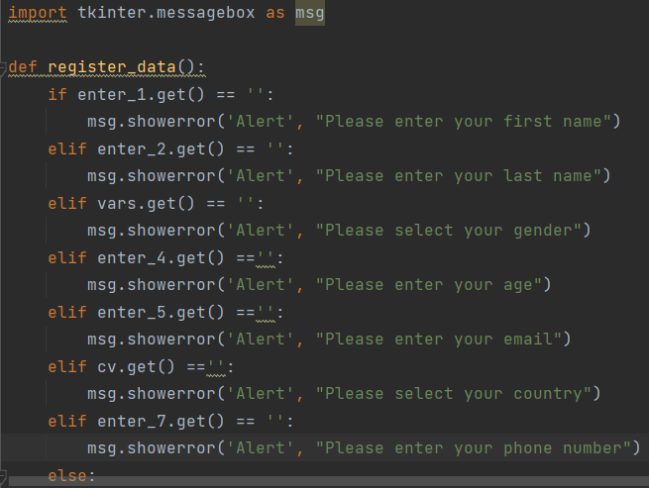
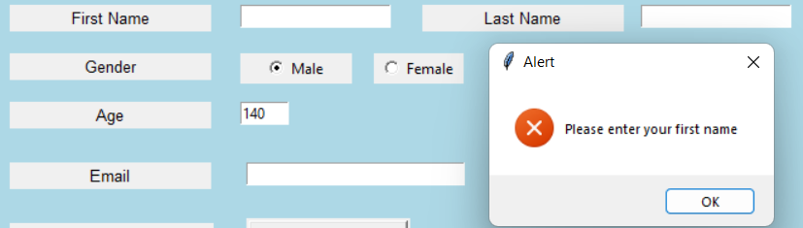
User Input validation
Now in python we import tkinter.messagebox module and create a method with the name register_data that includes a bunch of codes which will check whether the required fields are filled by the user and if the user leave out a field and press submit button, an alert will pop up asking the user to fill the required fields.
The method name is then added to the ‘command’ parameter of the submit button.

Slide 11
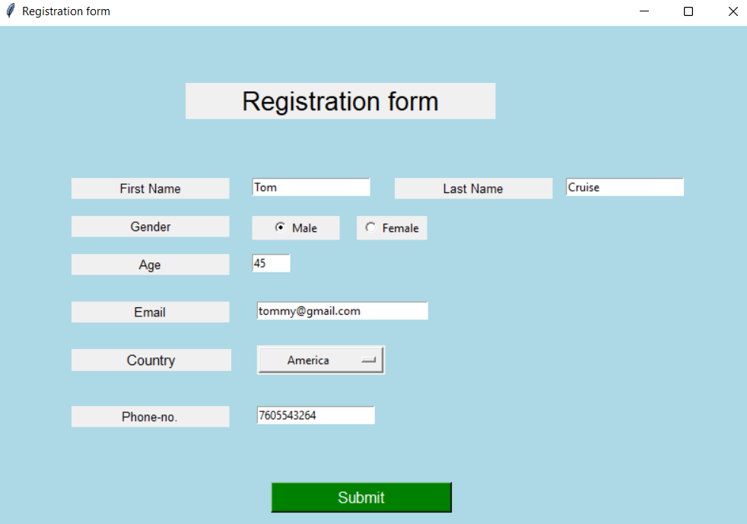


Once the user fills up all the input details and press on submit button, all the data will get stored in the table formdata in our mysql database.

Slide 12


